Slide 1
Observational Study
and
Experiment

Slide 2
Topics
Observational studies vs. experiments
Components of experiments
Principles of experimental design
Describing a completely randomized design

Slide 3
Topics
Observational studies vs. experiments
Components of experiments
Principles of experimental design
Describing a completely randomized design

Slide 4
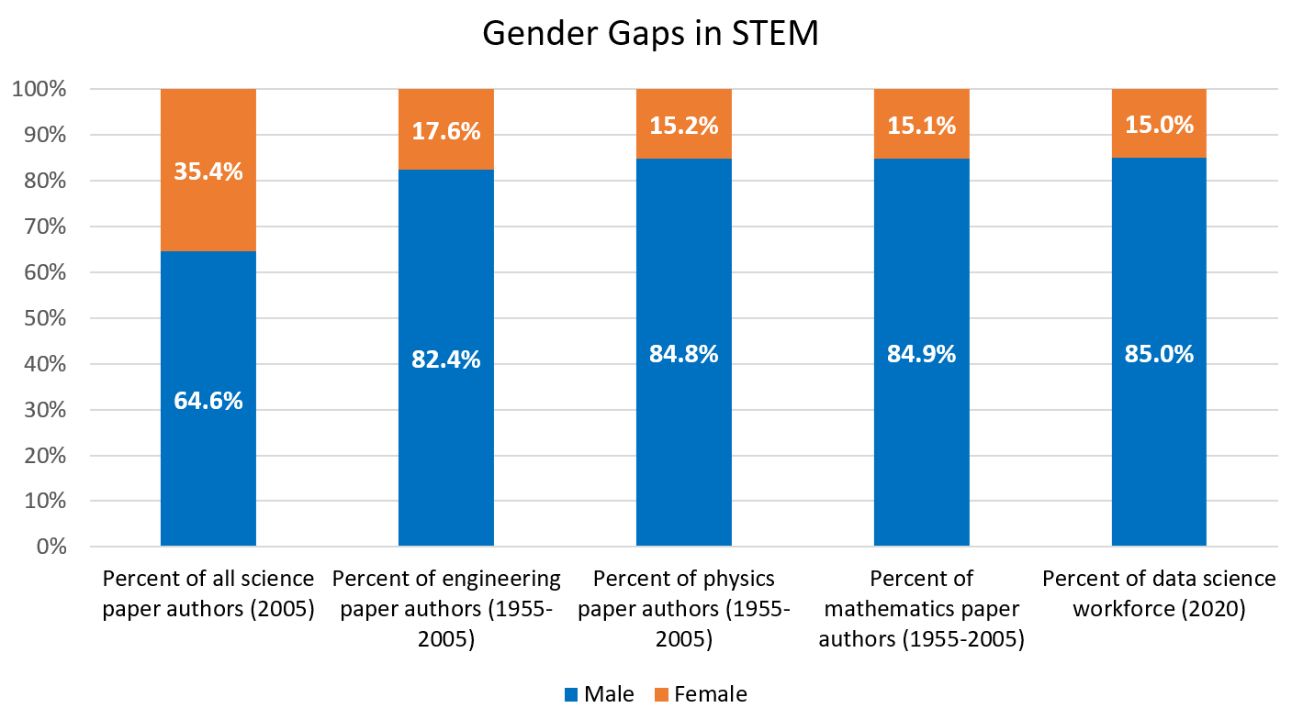
Gender Gaps in STEM
-Female
-Male
Sources:
-Huang, J. et al. “Historical comparison of gender inequality in scientific careers across countries and disciplines.” Proceedings of the National Academy of Sciences, Mar 2020, 117 (9) 4609-4616; DOI: 10.1073/pnas.1914221117
-Boston Consulting Group, “What’s Keeping Women out of Data Science?” bcg.com/publications/2020/what-keeps-women-out-data-science.aspx

Slide 5
Gender Gaps in STEM
-Female
-Male
Today’s Key Analysis
Is it possible to find the true cause of these gender gaps in science?

Slide 6
What causes this trend?
Possible Cause: Hiring Discrimination
Women are given fewer research and workforce opportunities in STEM due to:
discriminatory practices in research/industry hiring,
therefore, fewer women can enter or succeed in the field.

Slide 7
Can we prove this cause?
From this observed data alone, we cannot prove that hiring discrimination is the cause.
Why?

Slide 8
Can we prove this cause?
Drownings & Ice cream sales
Confounding variable: temperature
Attendance & GPA
Confounding variable: Poverty
Confounding variables:
Provide alternative explanations for trends between explanatory (gender) and response (hiring rates) variables.

Slide 9
Possible Confounding Variable
Confounding: Socialization
Women are given fewer research and workforce opportunities in STEM due to:
Many girls are not encouraged to pursue STEM subjects when they are growing up. Therefore, fewer women choose to pursue STEM as adults.

Slide 10
Possible Confounding Variable
Confounding: Socialization
Women are given fewer research and workforce opportunities in STEM due to:
Additionally, We tend to foster boys’ belief of talent in STEM which leads more men pursue STEM as adults.

Slide 11
What causes this trend?
1. Hiring discrimination?
2. Socialization?
3. A combo of #1 and #2?
4. Other causes?
5. A combo of #1, #2, and other causes?...
We don’t know! But maybe we can test it…

Slide 12
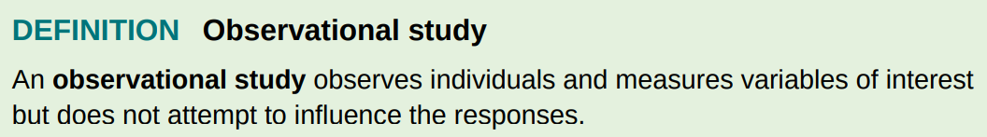
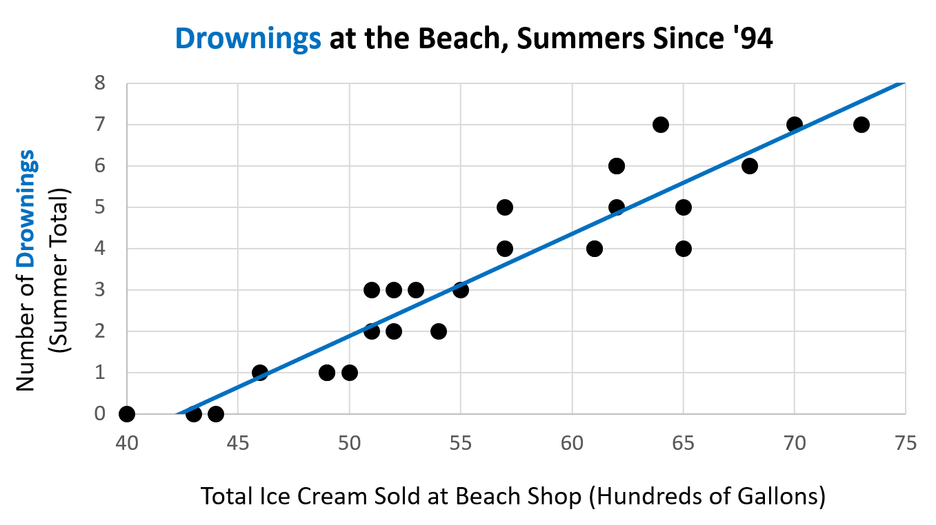
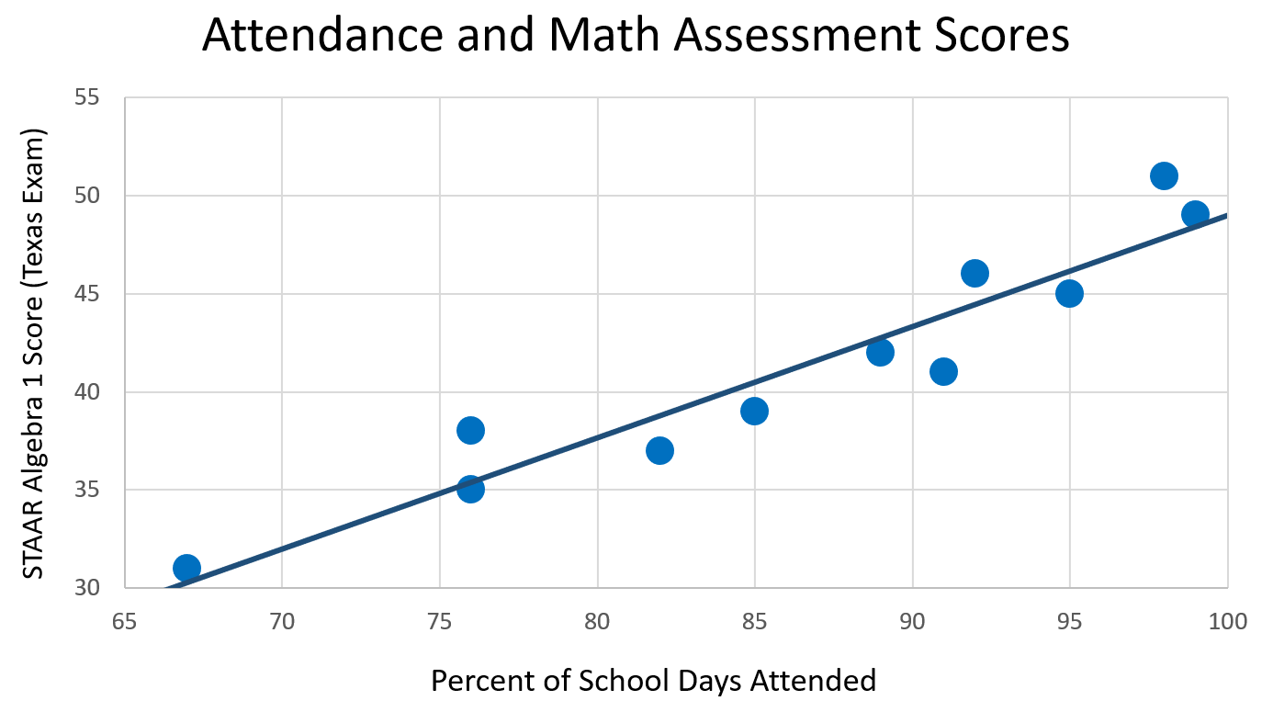
Cannot show cause and effect!

Slide 13
Experimental studies
Experiments: a study in which treatment is imposed on subjects.
-If well designed, experiments can show cause-effect relationships by controlling for confounding variables.

Slide 14
What causes this trend?
Possible Cause: Hiring Discrimination
How can we design an experiment to test this?

Slide 15
Observational Studies & Experiments
Observational Studies cannot show cause and effect because they do not control for confounding!
If well designed, experiments can show cause and effect by controlling for confounding variables.

Slide 16
Topics
Observational studies vs. experiments
Components of experiments
Principles of experimental design
Describing a completely randomized design

Slide 17
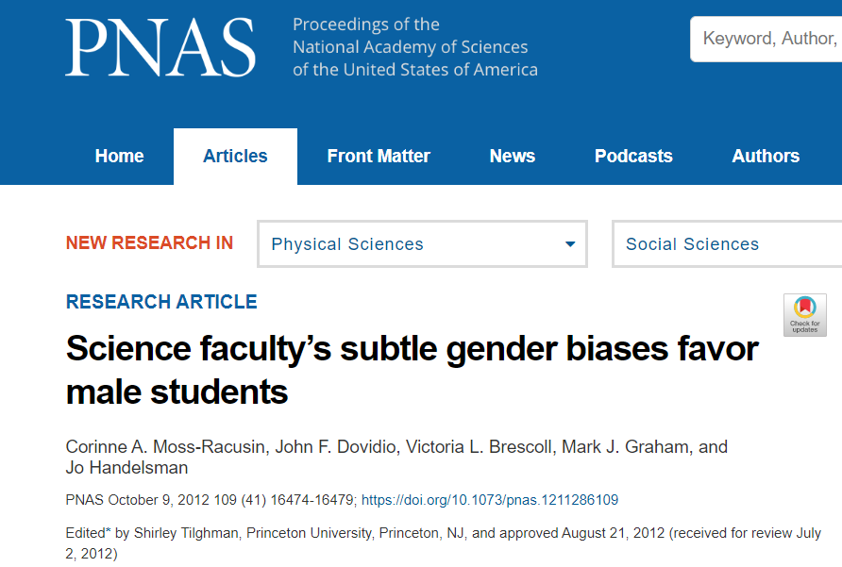
Researchers from Yale developed an experiment to test for gender bias in research lab hiring.
Moss-Racusin, C., Dovidio, J., et al. “Science faculty’s subtle gender biases favor male students.” PNAS October 9, 2012 109 (41) 16474-16479; https://doi.org/10.1073/pnas.1211286109

Slide 18
We’ll discuss a simplified version of what they did (read paper for full version)
Paper: Moss-Racusin, C., Dovidio, J., et al. “Science faculty’s subtle gender biases favor male students.” PNAS October 9, 2012 109 (41) 16474-16479; https://doi.org/10.1073/pnas.1211286109

Slide 19
The Jenn/John Experiment
Resumé
John Williams
University of Indiana
Major: Biology, GPA: 3.5
Experience
Research Assistant, Summer 2011
___________________________________________________________________________
Development Intern, Spring 2010
_________________________________________________________________________________________________
Resumé
Jennifer Williams
University of Indiana
Major: Biology, GPA: 3.5
Experience
Research Assistant, Summer 2011
___________________________________________________________________________
Development Intern, Spring 2010
_________________________________________________________________________________________________

Slide 20
The Jenn/John Experiment
Resumé
John Williams
University of Indiana
Major: Biology, GPA: 3.5
Experience
Research Assistant, Summer 2011
___________________________________________________________________________
Development Intern, Spring 2010
_________________________________________________________________________________________________
Resumé
Jennifer Williams
University of Indiana
Major: Biology, GPA: 3.5
Experience
Research Assistant, Summer 2011
___________________________________________________________________________
Development Intern, Spring 2010
_________________________________________________________________________________________________
John
Jennifer

Slide 21
The Jenn/John Experiment
Resumé
John Williams
University of Indiana
Major: Biology, GPA: 3.5
Experience
Research Assistant, Summer 2011
___________________________________________________________________________
Development Intern, Spring 2010
_________________________________________________________________________________________________
Resumé
Jennifer Williams
University of Indiana
Major: Biology, GPA: 3.5
Experience
Research Assistant, Summer 2011
___________________________________________________________________________
Development Intern, Spring 2010
_________________________________________________________________________________________________
John
Jennifer
“have been pretested as equivalent in likability and recognizability…” – study authors

Slide 22

The Jenn/John Experiment
n = 127

Slide 23
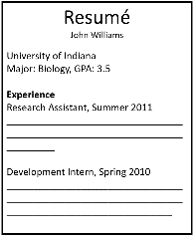
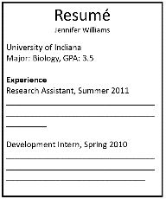
The Jenn/John Experiment
n = 127
John
Jennifer

Slide 24
The Jenn/John Experiment
n = 127
John
Jennifer

Slide 25
The Jenn/John Experiment
John
Jennifer
n₁ = 63
n₂ = 64

Slide 26
The Jenn/John Experiment
Measured which group gave the applicant …
-Better “hireability” ratings
-A higher starting salary estimate
John
Jennifer
n₁ = 63
n₂ = 64

Slide 27
Components of experiments
Experimental units: the individuals/subjects (person, animal, plant, virus, particle, etc.) that are assigned to different treatments.
In hiring study: Science lab faculty
Explanatory variable: the variable that is purposefully manipulated. This is also known as the factor.
In hiring study: Applicant name

Slide 28
Components of experiments
Treatments: the different levels of the explanatory variable in the experiment.
In hiring study: Jennifer/John
Response variable: the measured experiment outcome that is compared between treatment groups.
In hiring study: “Hireability” rating and salary estimate

Slide 29
Topics
Observational studies vs. experiments
Components of experiments
Principles of experimental design
Describing a completely randomized design

Slide 30
Principles of Experimental Design
Comparison of at least two treatment groups
Random assignment of experimental units to treatment
Replication – many experimental units in each treatment group
Control of confounding variables

Slide 31
Comparison
John
Jennifer

Slide 32
Comparison
John
Jennifer

Slide 33

Comparison
Comparing at least two treatments
John
Jennifer

Slide 34
Random Assignment
John
Jennifer

Slide 35
Random Assignment
Tier 1
Tier 2
John
Jennifer

Slide 36
Random Assignment
What if I assigned Tier 1 University labs to get “John” and Tier 2 labs to get “Jennifer”?
Tier 1
Tier 2
John
Jennifer

Slide 37
Random Assignment
Tier 1
Tier 2
John
Jennifer

Slide 38
Random Assignment
Now we have confounding! Not sure if it’s gender or lab quality that causes hiring outcome differences.
Tier 1
Tier 2
John
Jennifer

Slide 39
Random Assignment
Tier 2
Tier 2
Tier 1
Tier 1
Tier 1
Tier 1
Tier 2
Tier 2
John
Jennifer

Slide 40
Random Assignment
Tier 2
Tier 2
Tier 1
Tier 1
Tier 1
Tier 1
Tier 2
Tier 2
John
Jennifer

Slide 41
Random Assignment
Tier 1
Tier 1
Tier 1
Tier 2
Tier 1
Tier 2
Tier 2
Tier 2
John
Jennifer

Slide 42
Random Assignment
Random assignment tends to balance confounding factors, so inferences can be made about the explanatory variable.
Tier 1
Tier 1
Tier 1
Tier 2
Tier 1
Tier 2
Tier 2
Tier 2
John
Jennifer

Slide 43
Terminology
Sampling
Experiments
Random sample
Reduces bias
Random assignment
Reduces confounding

Slide 44
Replication
n = 2
Just two experimental units (two faculty). Randomly assign to treatment.
John
Jennifer

Slide 45
Replication
n = 2
Just two experimental units (two faculty). Randomly assign to treatment.
John
Jennifer

Slide 46
Replication
John
Jennifer
n₁ = 1
n₂ = 1

Slide 47
Replication
Hard to tell if differences are due to explanatory variable (gender) or chance variation between these two faculty.
Ex: maybe one of the faculty members was having a
bad morning while reading applications
John
Jennifer
n₁ = 1
n₂ = 1

Slide 48
Replication
n = 127

Slide 49
Replication
n = 127
John
Jennifer

Slide 50
Replication
n = 127
John
Jennifer

Slide 51
Replication
Larger treatment group size reduces the likelihood of differences arising due to chance alone. In other words, it makes our estimates of treatment effect more precise.
John
Jennifer
n₁ = 63
n₂ = 64

Slide 52
Control
Resumé
John Williams
University of Indiana
Major: Biology, GPA: 3.5
Experience
Research Assistant, Summer 2011
___________________________________________________________________________
Development Intern, Spring 2010
_________________________________________________________________________________________________
Resumé
Jennifer Williams
University of Indiana
Major: Biology, GPA: 3.5
Experience
Research Assistant, Summer 2011
___________________________________________________________________________
Development Intern, Spring 2010
_________________________________________________________________________________________________

Slide 53
Control
One way they control for confounding factors is by making the application materials completely identical, except for the explanatory variable (gender).
They even control for name likability:
Jennifer/ John “have been pretested as equivalent in likability and recognizability…”
Resumé
John Williams
University of Indiana
Major: Biology, GPA: 3.5
Experience
Research Assistant, Summer 2011
___________________________________________________________________________
Development Intern, Spring 2010
_________________________________________________________________________________________________
Resumé
Jennifer Williams
University of Indiana
Major: Biology, GPA: 3.5
Experience
Research Assistant, Summer 2011
___________________________________________________________________________
Development Intern, Spring 2010
_________________________________________________________________________________________________

Slide 54
Topics
Observational studies vs. experiments
Components of experiments
Principles of experimental design
Describing a completely randomized design

Slide 55
Completely Randomized Design
Completely randomized design:
An experimental design in which experimental units are assigned to treatments completely at random.

Slide 56
Describing an experiment
Describe how you would implement a completely randomized design of the Jennifer/John experiment, with 127 science faculty members.

Slide 57
Describing an experiment
Key Steps:
1. Assign each experimental unit a number 1 – n (sample size).
2. Write all the numbers on identical slips of paper, put into a hat, and mix well.
3. Draw out n_{t} (treatment group size) slips of paper, without replacement. The corresponding units are assigned treatment 1. Draw out another n_{t} slips of paper, assign to treatment 2, etc.
4. Compare response among treatment groups

Slide 58
Describing an experiment
Describe how you would implement a completely randomized design of the Jennifer/John experiment, with 127 science faculty members.

Slide 59
Describing an experiment
Assign each faculty member an integer, 1-127. Write integers 1-127 on identical slips of paper, put them into a hat, and mix well. Draw out 63 slips (without replacement). The corresponding faculty members will receive “John” application materials. The remaining faculty members will receive “Jennifer” application materials. At the end of the experiment, record faculty members’ rating of applicants’ “hireability” and starting salary estimates. Finally, compare these results across the two groups.

Slide 60
Discussion

Slide 61
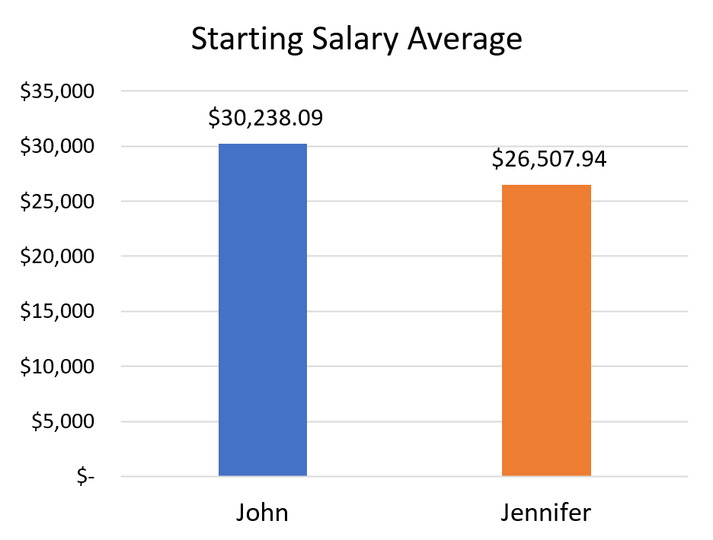
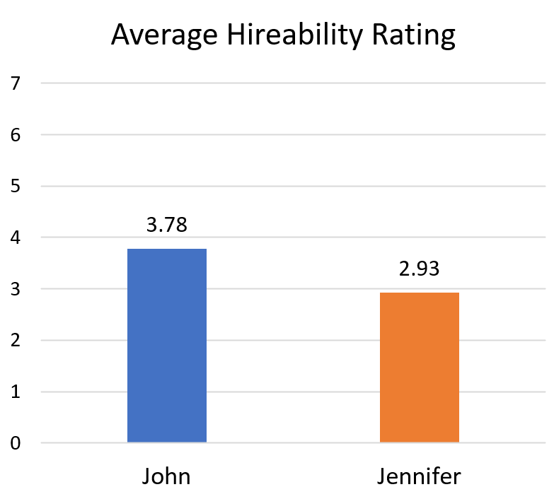
Experiment results

Slide 62
Experiment results
-$3,730
-0.85
 | John | Jennifer | Difference
Hireability | 3.78 | 2.93 | -0.85
Salary | $30,238 | $26,508 | -$3,730

Slide 63
Experiment results
The differences were found to be statistically significant:
so extreme that they were unlikely to happen by chance alone.
-$3,730
-0.85

Slide 64
Experiment results
Since this was a well-designed experiment, we can infer that these average differences are caused by gender bias.
-$3,730
-0.85

Slide 65
Gender Gaps in STEM
-Female
-Male

Slide 66
Gender Gaps in STEM
Discussion Question: Is the proven gender bias among the faculty in this study enough to explain the large gender gaps in STEM? Or might there be other causes as well? Explain your reasoning.

Slide 67
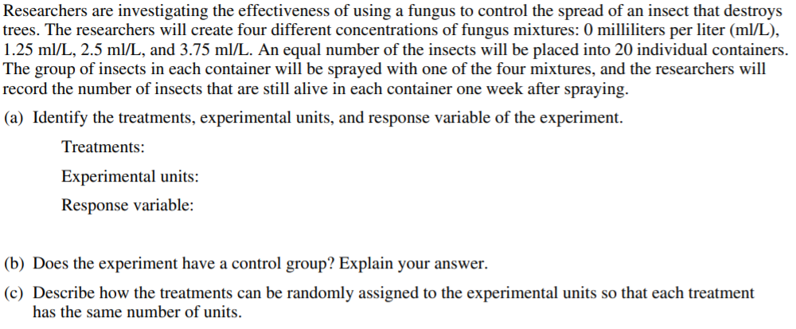

Slide 68
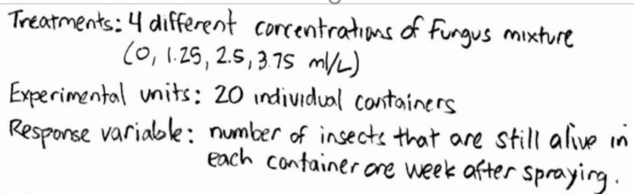

Slide 70
